Slide 1
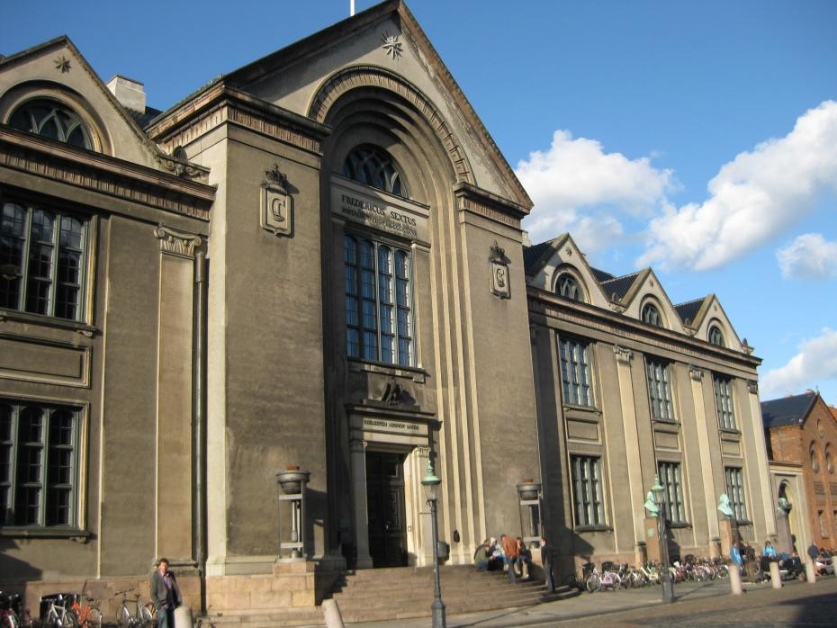

Summer school Online Learning 28.06.2015-02.07.2015 Copenhagen University

Slide 2
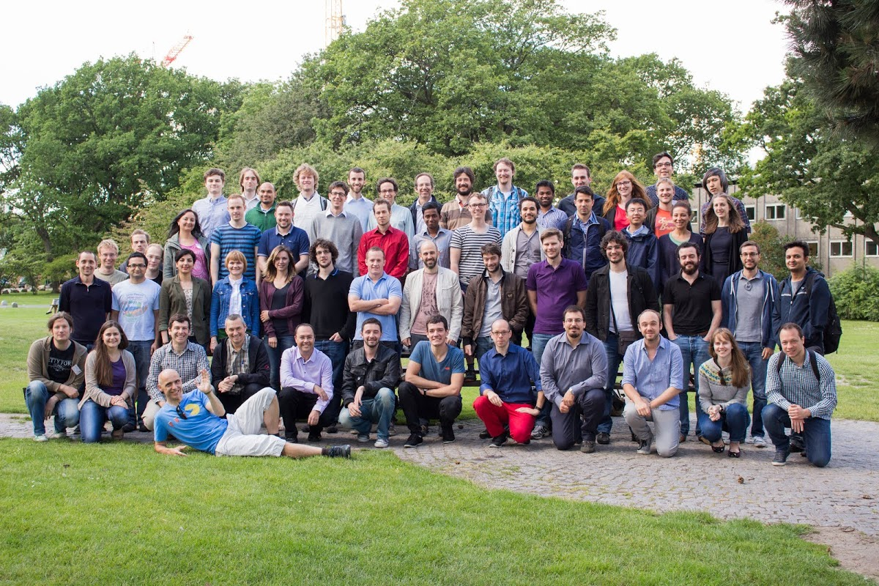
Participants

Slide 3

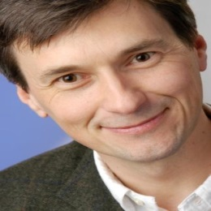



Participants & Lecturer
Around 60 participants
Lecturer
Shai Shalev-Shwartz, Hebrew University
Peter Auer, Leoben University
Nicola Cesa-Bianchi, Miland University
Csaba Szepesvari, Alberta University
Yevgeny Seldin, Copenhagen University

Slide 4
Topics
Basics of online learning
Online convex optimization
Bandits (stochastic, adversarial….)
Online reinforcement learning
Space of online learning problems
Theory only, proof of bounds

Slide 5
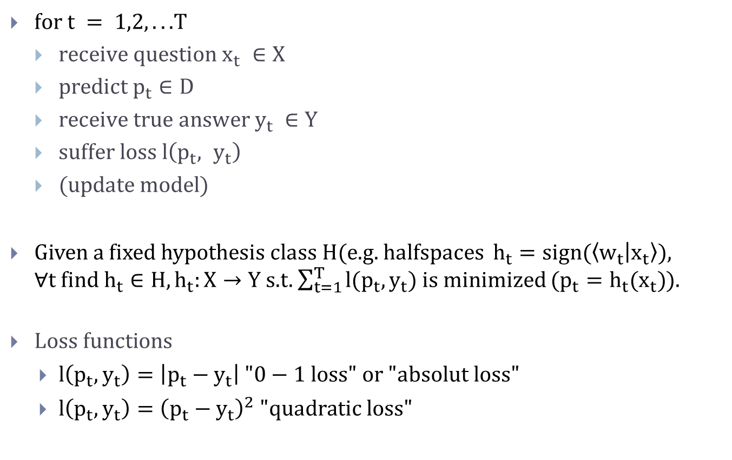
General online learning problem
$for t = 1,2, . . .$T
$receive question x_{t} ∈X$
$predict p_{t}∈D$
$receive true answer y_{t} ∈Y$
$suffer loss l\left(p_{t}, y_{t}\right)$
(update model)
Given a fixed hypothesis class H(e.g. halfspaces $h_{t}=sign(\left\langle w_{t} | x_{t}\right\rangle )$, $∀t find h_{t}∈H, h_{t}:X→Y$ s.t. $\sum_{t=1}^{T}{l(p_{t}, y_{t})}$ is minimized ($p_{t}=h_{t}(x_{t})$).
$Loss functions$
$l\left(p_{t}, y_{t}\right)=\left|p_{t}−y_{t}\right| "0−1 loss" or "absolut loss"$
$l\left(p_{t}, y_{t}\right)={\left(p_{t}−y_{t}\right)}^{2} "quadratic loss"$

Slide 6
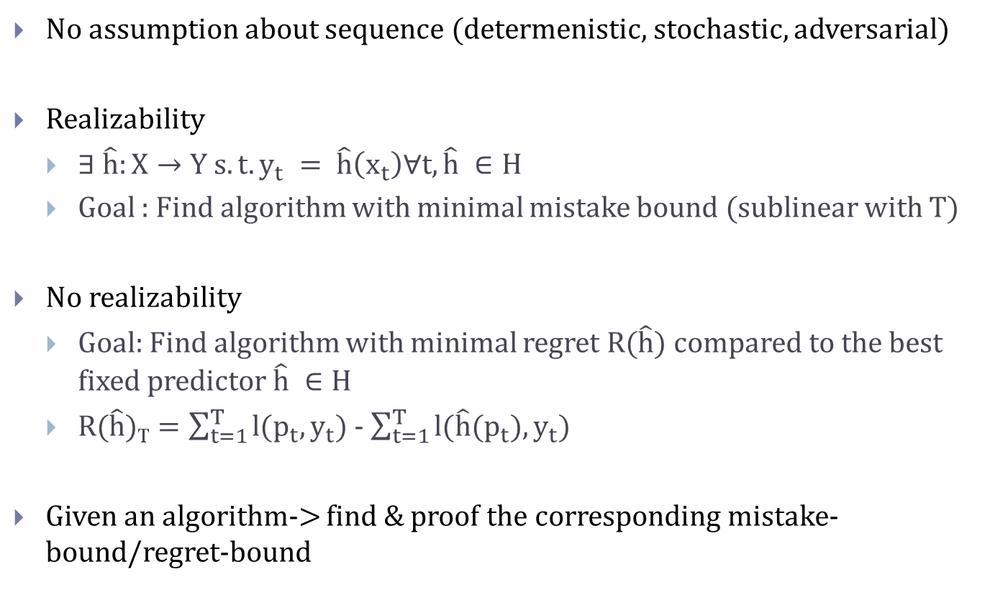
2 alternative restrictions/goals
No assumption about sequence (determenistic, stochastic, adversarial)
Realizability
$∃ \hat{h}:X→Y s.t. y_{t} = \hat{h}\left(x_{t}\right)∀t, \hat{h} ∈H$
Goal : Find algorithm with minimal mistake bound (sublinear with T)
No realizability
Goal: Find algorithm with minimal regret R($\hat{h}$) compared to the best fixed predictor $\hat{h} ∈H$
$R(\hat{h})T=\sum_{t=1}^{T}{l(p_{t}, y_{t})}$ - $\sum_{t=1}^{T}{l(\hat{h}(p_{t}), y_{t})}$
Given an algorithm-> find & proof the corresponding mistake-bound/regret-bound

Slide 7
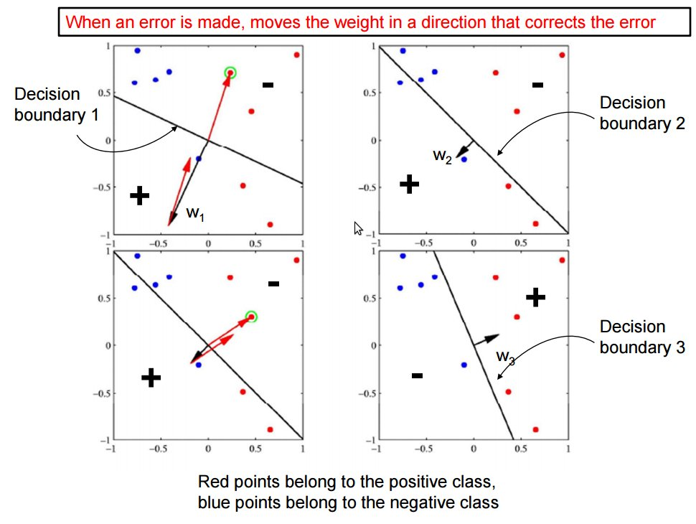
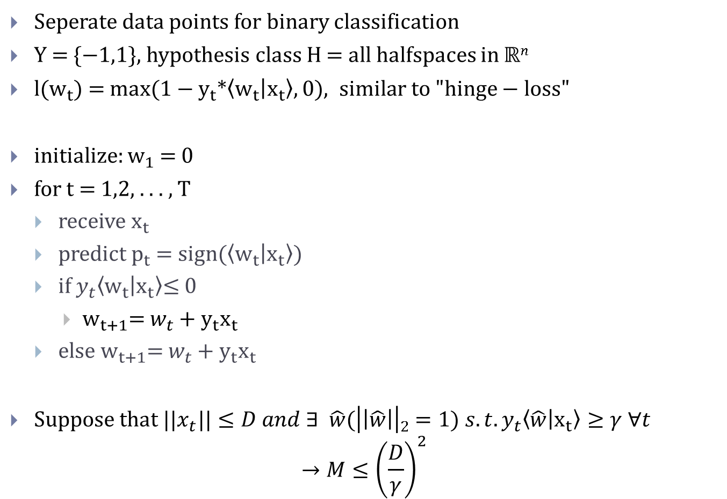
Perceptron for realizability case
Seperate data points for binary classification
Y = {−1,1}, hypothesis class H = all halfspaces in $ℝn$
l($w_{t}$) = max(1 − $y_{t}$*$\left\langle w_{t} | x_{t}\right\rangle , 0), similar to "hinge−loss"$
initialize: $w_{1}$= 0
for t = 1,2, . . . , T
receive $x_{t}$
predict $p_{t}$ = sign($\left\langle w_{t} | x_{t}\right\rangle$)
if $y_{t}\left\langle w_{t} | x_{t}\right\rangle$≤ 0
$w_{t+1}$= $w_{t}$ + $y_{t}x_{t}$
else $w_{t+1}$= $w_{t}$ + $y_{t}x_{t}$
Suppose that ||$x_{t}||≤D and ∃ \hat{w}(\left|\left|\hat{w}\right|\right|2=1) s.t. y_{t}\left\langle \hat{w} | x_{t}\right\rangle ≥γ ∀t$
$$→M≤{\left(\frac{D}{γ}\right)}^{2}$$

Slide 8
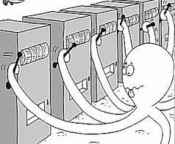
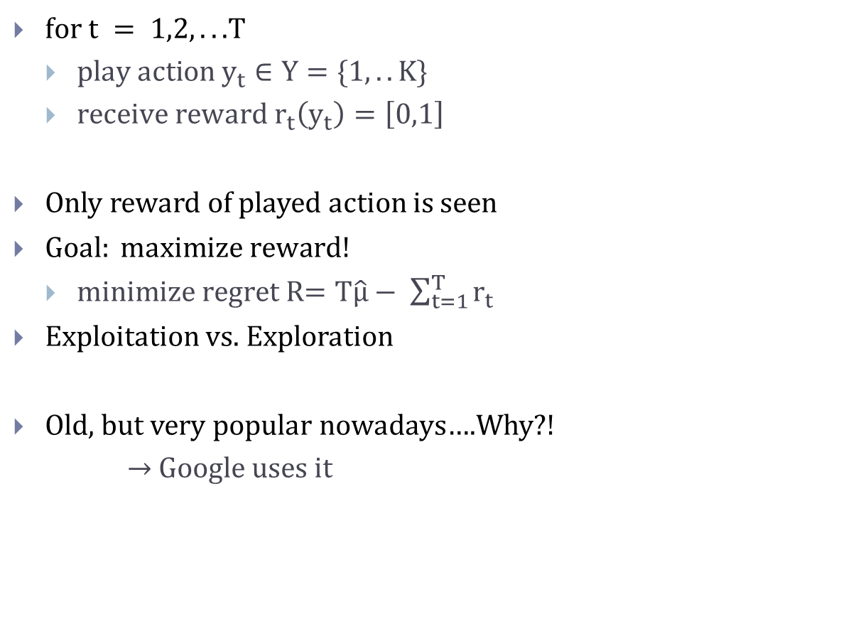
Multi-armed Bandits
$for t = 1,2, . . .$T
$play action y_{t}∈Y=\{1,..K\}$
$receive reward r_{t}\left(y_{t}\right)=\left[0,1\right]$
Only reward of played action is seen
$Goal: maximize reward!$
$minimize regret$R$=T\hat{μ}− \sum_{t=1}^{T}{r_{t}}$
Exploitation vs. Exploration
Old, but very popular nowadays….Why?!
$→$Google uses it

Slide 9
Multi-armed Bandits
Various versions
Stochastic stationary/non-stationary
Adversarial, Contextual
Graph-based
Applications
Web-searches (contextual, max adv. income of Google, Bing etc.)
Clinical trials (minimize patient losses)
Adaptive routing (minimize delays)

Slide 10

Stochastic, stationary Bandits
Rewards for actions are generated by stationary distributions
R(T) = $T\hat{μ}− \sum_{j=1}^{K}{μ_{j}}∗T_{j}, T_{j} is the number action j was played$
Estimate $μ_{k}$ accurately to minimize the regret

Slide 11
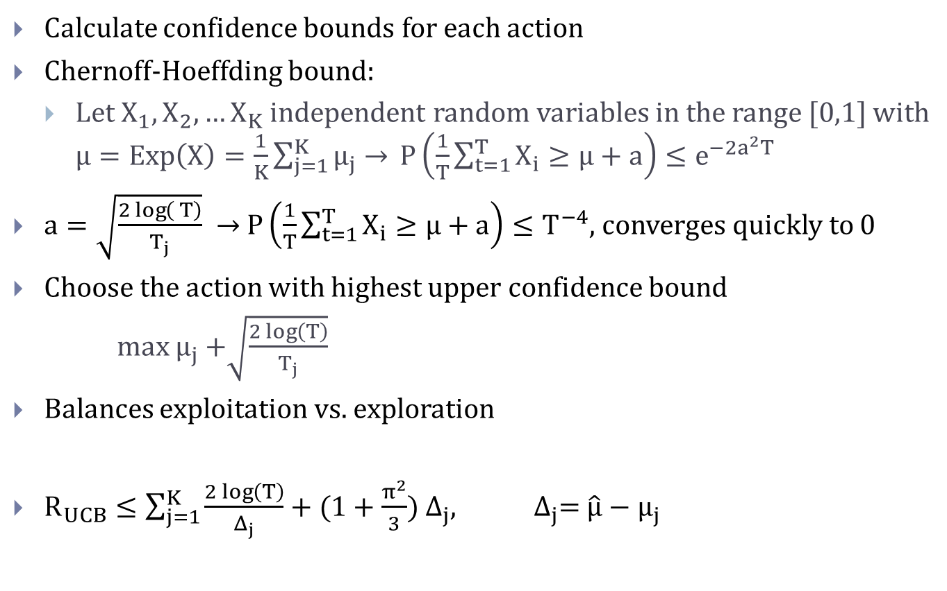
Upper Confidence Bound (UCB) algorithm
Calculate confidence bounds for each action
Chernoff-Hoeffding bound:
$Let X_{1},X_{2},…X_{K}$ independent random variables in the range [0,1] with $μ=Exp\left(X\right)=\frac{1}{K}\sum_{j=1}^{K}{μ_{j}→ }P\left(\frac{1}{T}\sum_{t=1}^{T}{X_{i}≥μ+a}\right)≤e^{−2a^{2}T}$
$a=\sqrt{\frac{2\log\left( T\right)}{T_{j}}} →$ $P\left(\frac{1}{T}\sum_{t=1}^{T}{X_{i}≥μ+a}\right)≤T^{−4}$, converges quickly to 0
Choose the action with highest upper confidence bound
max $μ_{j}$ +$\sqrt{\frac{2\log\left(T\right)}{T_{j}}}$
Balances exploitation vs. exploration
$R_{UCB}≤\sum_{j=1}^{K}{\frac{2\log\left(T\right)}{Δ_{j}}}+(1+\frac{π^{2}}{3})$ $Δ_{j}$, $Δ_{j}$= $\hat{μ}−μ_{j}$

Slide 12
Further readings
Got interested ?
Shai Shalev-Shwartz “Online Learning and Online Convex Optimization”
Sebastien Bubeck, Nicolò Cesa-Bianchi „Regret Analysis of Stochastic andNon-stochastic Multi-armedBandit Problems“
Nicolò Cesa-Bianchi “Prediction, learning, and games”

